Slide 1
Digital Angel
Workshops

Slide 2
Workshops
Digital Angel MVP Requirements
  Understanding the high level requirements
  Defining the Customer User Stories (Product Owner)
  Defining Technical User Stories (Solution Architect)
Day-1: 21.May.2020 (Thursday)
  12:00 – 13:00 Session-1 (Requirements, Reference Architecture)
  14:00 – 15:00 Session-2 (Identify Stories)
Day-2: 22.May.2020 (Friday)
  10:00 – 11:00 Session-1 (Product Backlog – Write stories)
  14:00 – 15:00 Session-2 (Product Backlog – Write stories)

Slide 3
Guidelines to design/analyze features
Define a legend
  Representing a Database
  Representing a role/user
  Representing reports
  Representing telemetry data
  Representing relationships
  Describing the lines
Every feature must have inputs, process, output and role
Every feature must be simple and capture the minimum scope for the feature

Slide 4
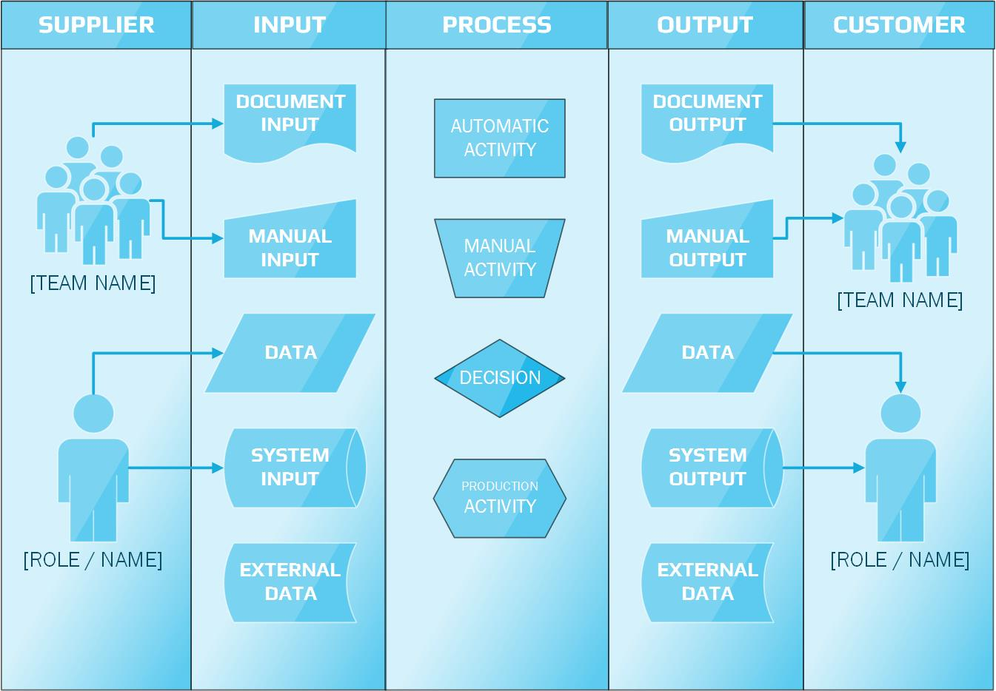

Slide 5
Scope of Minimum Viable Product (MVP)
Inputs provided by Deak
1. Ability to upload/track/enter mattress and sensor information
2. Ability to assign mattress to an entity (room/patient)
3. Ability to track patients
4. Creation of a Nurse/Caregiver community to view patient activity
5. Integration/canvas with smart mattress with visual of weight movement
6. Ability to create reports based off real time data
7. Ability to create/modify alerts based off real time data
8. Ability to manage Org users/licenses
9. Ability to assign patients to a Nurse/Caregiver
10. Must have ability to be HIPPA compliant (discuss further)
11. Architecture must allow for multiple locations for one customer
12. Must have multiple and modifiable role-based structure
13. Should be mobile ready
14. Must have ability to track patient/caregiver interaction

Slide 6
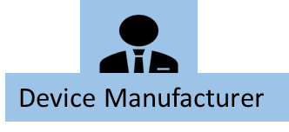


Feature: Ability to upload/track/enter mattress and sensor information
Supplier
Input
Process
Script
Output
Customer
UI
SQL
Device Metadata
CSV/Excel/JSON
Upload Mattress and Sensor information
Device DB
Enter Mattress and Sensor information
Device Metadata
(Manual Entry)
Patient DB
Track the mattress and sensor
Device DB
Device DB
Room
DB
Tracking Report

Slide 7



Feature: Ability to assign mattress to an entity (room/patient)
Supplier
Input
Script
Process
Output
Customer
UI
SQL
Assign mattress to a Patient
Patient DB
Assign mattress to a Room
Patient –Mattress Assigned DB
Device DB
Update
Patient information
Room
DB
Alerts & Actions
Update
Room Information

Slide 8



Feature: Ability to track patient
Supplier
Input
Process
Output
Customer
Script
UI
SQL
Healthcare DB
Track Patient movement
Reports
Patient
DB
Alerts & Actions

Slide 9



Feature: Creation of a Nurse/Caregiver community to view patient activity
Supplier
Input
Process
Script
Output
Customer
UI
SQL
Caregiver
DB
Nurse/Caregiver information
Patient Activity Report
Healthcare DB
Patient information
Reports
Patient DB

Slide 10



Feature: Integration/Canvas with Smart Mattress visual of Weight movement
Supplier
Input
Process
Output
Customer
Script
UI
SQL
Patient DB
Sensor DB
Weight Movement Visualization
Reports
Mattress DB
Threshold Values, Alerts, Actions
Alerts & Actions

Slide 11


Feature: Ability to create reports based off real time data
Supplier
Input
Process
Script
Output
Customer
UI
SQL
Patient Information
Sensor Telemetry Data
Analytics
Reports
Patient DB
Sensor DB

Slide 12

Feature: Ability to create/modify alerts based off real time data
Supplier
Input
Process
Script
Output
Customer
UI
SQL
Set of Rules/Instructions
Modified Patient DB
Sensor Device Realtime Data
Triggers
Send alerts to Caregiver
Mattress DB
Alert Log
Patient DB
Sensor DB

Slide 13



Feature: Ability to manage org users/licenses
Supplier
Input
Process
Script
Output
Customer
UI
SQL
Grant or restrict permissions
ModifiedAdmin DB
Admin DB
Licensing
Manage User’s
And Access

Slide 14



Feature: Ability to assign patients to a Nurse/Caregiver
Supplier
Input
Process
Output
Customer
Rules
Caregiver
DB
Patient-Caregiver Assignment
DB
Patient DB
Assign Nurse to a Patient
Room DB
Assign Caregiver to a Patient

Slide 15


Feature: Architecture must allow for multiple locations for one customer
Supplier
Input
Process
Output
Customer
Patient Information
ORG
Designing Architecture
Block-A
Room
Patient DB
Feature: Architecture must allow for multiple locations for one customer

Slide 16



Feature: Must have multiple and modifiable role-based structure
Supplier
Input
Process
Output
Customer
Modify/alter
Nurse/Caregiver Roles
Modified Admin DB
Admin DB
Caregiver DB
Modified Nurse/Caregiver DB
Modify/alter
System Roles

Slide 17




Feature: : Should be mobile ready
Supplier
Input
Process
Output
Customer
Access
App Access
Mobile Access Ready

Slide 18

Feature: : Must have ability to track patient/Caregiver interaction
Supplier
Input
Process
Output
Customer
Chatter
Patient Information
Tracking
Nurse/Caregiver Information
Alert/Text History

Slide 19
Ability to be HIPPA compliant

Slide 20
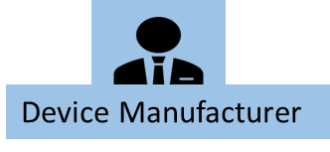

Digital Angel - User Roles
Term Definition | Description
 | Device Manufacturer Responsible for providing the metadata of the device
 | Digital Angel Administrator Responsible for managing the Digital Angel administration tasks

Slide 21
Digital Angel – Databases (DB)
Term Definition | Description
 | Patient Database
 | Device Database
 | Caregiver Database
Patient DB
Device DB
Caregiver
DB

Slide 22
Appendix

Slide 23
Feature: Ability to upload/track/enter mattress and sensor information
Excel/CSV/JSON
Script
Sensor DB
Patient information
UI
SQL
Script
Ability to upload/track/enter mattress and sensor information
Upload Mattress and Sensor information
Track the mattress and sensor
When it is assigned to a patient
Enter Mattress and Sensor information
When it is NOT assigned to a patient
When it is assigned and then found to be not operational
When it is not operational
When it is in the store
Mattress DB

Slide 24
Feature: Ability to assign mattress to an entity (room/patient)
Scripts
Patient –Mattress Assigned DB
Mattress DB
Alerts & Actions
Get Mattress ID
UI
SQL
Ability to assign mattress to an entity (room/patient)
Get Patient ID
Assign mattress to a Patient
Patient information
Patient DB
Assign mattress to a Room
Room Information
Room DB
Get Room ID

Slide 25
Feature: Ability to track patient
Scripts
UI
SQL
Alerts
Health
Care DB
Ability to track Patients
Patient information
Patient DB
Patient_id
In Patient
Remote patient
Reports

Slide 26
Feature: Creation of a Nurse/Caregiver community to view patient activity
Scripts
Nurse/Caregiver DB
Sensor Device Output images
UI
SQL
Creation of a Nurse/Caregiver community to view patient activity
Patient Tracker
Healthcare DB
Patient DB
Sensor Device Information

Slide 27
Feature: Integration/Canvas with Smart Mattress visual of Weight movement
Scripts
Patient DB
UI
SQL
Alerts & Actions
Patient_Id
Integration/Canvas with Smart Mattress visual of Weight movement
Sensor Information
Heat Map Visualization
Sensor DB
Reports
Mattress_Id
Mattress DB

Slide 28
Feature: Ability to create reports based off real time data
Patient DB
Scripts
UI
SQL
Ability to create reports based off real time data
Nurse/caregiver
Patients Experience on Medical condtion
Reports
Patient
Sensor Telemetry Data
Sensor DB

Slide 29

Feature: Ability to create/modify alerts based off real time data
Scripts
Action takes place
Set of Rules/Instructions
?
Modified Patient DB
UI
SQL
Text/Mail
?
Ability to create/modify alerts based off real time data
Mattress DB
System Admin
Alerts
Send alert to Caregiver
Get Patient real time data
Get sensor real time data
Alert Log
Mobile Device
Patient DB
Sensor Device

Slide 30
Scripts
Grant or restrict permissions
UI
SQL
Permissions Enable/Disable
Ability to manage Org users/licenses
Admin DB
ModifiedAdmin DB
User’s/Roles
Subscription
Licensing
Manage User’s
And Access

Slide 31
9
Room Information
Patient DB
Ability to assign patients to a Nurse/Caregiver
Patient_Id
ModifiedPatient DB
Nurse manger
Nurse_Id
Caregiver_Id
Assign Nurse to a Patient
Assign Caregiver to a Patient
Nurse/Caregiver information

Slide 32
Architecture must allow for multiple locations for one customer
Updated
Patient DB
ORG
BLOCK-A
BLOCK-B
Patient Information
Room-1
Room-2
Patient DB

Slide 33

Admin DB
CRUD Functionalities
Modify/alter
Nurse/Caregiver Roles
Modified Nurse/Caregiver DB
System Admin
Update
Must have multiple and modifiable role-based structure
Role_Id
Nurse Manager
Nurse_Id
Modified Admin DB
Modify/alter
System Roles
Update
Nurse/Caregiver DB

Slide 34


Users
Should be mobile ready
App Access
System Admin
Access
App Access
Community
App Access
Product Owner

Slide 35
Patient information
Must have ability to track patient/caregiver interaction
Patient_Id
Tracking
Chatter
Nurse/caregiver information
alert/text history

